Slide 1

Introduction to Prompt Engineering
Overview of Prompt Engineering
Importance of Crafting Effective Prompts
Examples of Effective Prompts
Notes:
(1:30 - 1:45) 15 minutes
**One Sentence Summary**
- "Introduce the concept of prompt engineering and explain its importance in crafting effective prompts for AI tools."
**Detailed Notes**:
- **Overview of Prompt Engineering**:
- **Definition**:
- Prompt engineering is the process of designing and refining the input prompts given to AI tools, such as ChatGPT and GitHub Copilot, to elicit useful and relevant responses.
- **Role in AI Tools**:
- Effective prompt engineering helps leverage AI capabilities for various tasks, including code generation, debugging, and creating documentation.
- **Example**:
- "When using ChatGPT to generate code, a well-crafted prompt might be: 'Write a Python function to merge two sorted lists into a single sorted list.' This provides clear instructions and context for the AI to generate accurate and relevant code."
- **Importance of Crafting Effective Prompts**:
- **Accuracy and Relevance**:
- The quality of the prompt directly impacts the relevance and accuracy of the AI's response. Ambiguous or vague prompts can lead to incorrect or incomplete outputs.
- **Efficiency**:
- Well-crafted prompts save time by reducing the need for multiple iterations to refine the AI's output.
- **Example**:
- "For debugging, a prompt like: 'Find the error in this Python code snippet for calculating factorials' is more effective than 'Fix this code,' as it provides specific context and expectations."
- **Examples of Effective Prompts**:
- **Code Generation**:
- "Generate a function in C# that sorts an array using quicksort."
- This prompt specifies the programming language and the algorithm, making it clear what is required.
- **Debugging**:
- "Identify the logical error in this Java code for computing the Fibonacci sequence."
- This prompt helps the AI focus on logical errors rather than syntax or other types of issues.
- **Documentation**:
- "Create documentation for a REST API endpoint that retrieves user information by ID."
- This prompt indicates the type of documentation needed and the specific functionality to be documented.
**Background Information**:
- **History of Prompt Engineering**:
- Prompt engineering has gained prominence with the rise of AI language models like GPT-3 and GPT-4. Initially, AI tools required extensive training data and fine-tuning to perform specific tasks. With advancements in AI, particularly in natural language processing, prompt engineering has become a practical approach to harness AI capabilities without extensive customization.
- The concept aligns with the broader trend of making AI more accessible and user-friendly, allowing non-experts to benefit from advanced AI functionalities by simply crafting effective prompts.
**Example**:
- **Real-world Scenario**:
- "In a software development project, a developer might use GitHub Copilot to write boilerplate code for setting up a REST API. By crafting a prompt like 'Generate the initial setup for a REST API in Express.js,' the developer can quickly get a functional codebase and focus on implementing specific features."

Slide 2
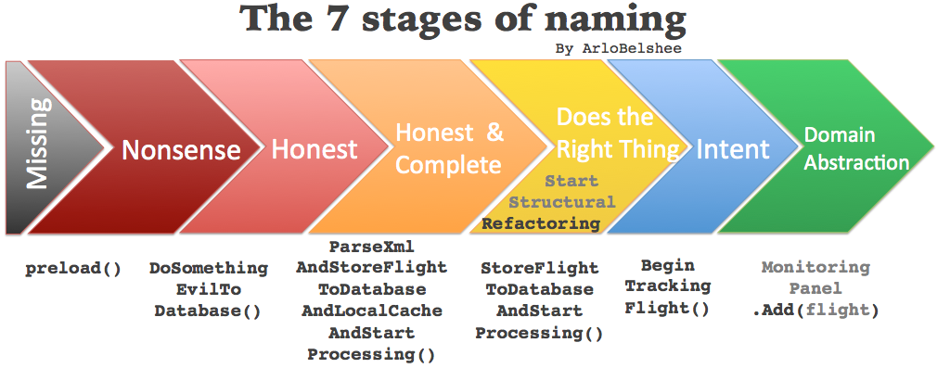
Notes:
(1:45 - 1:50) 5 minutes
**One Sentence Summary**
- "Discuss the seven stages of naming in coding to emphasize the importance of clarity and consistency in naming variables, functions, and classes."
**Detailed Notes**:
- **Overview of the 7 Stages of Naming**:
- **Stage 1: Tentative Name**:
- Start with a provisional name that describes the basic function or data of the variable, function, or class.
- **Example**:
- "For a function that adds two numbers, a tentative name could be `AddTwoNumbers`."
- **Stage 2: Refine Name Based on Context**:
- Refine the name to be more specific based on the context in which it is used.
- **Example**:
- "If the function adds two integers, refining the name to `AddTwoIntegers` provides more clarity."
- **Stage 3: Ensure Consistency with Naming Conventions**:
- Ensure the name follows the project's naming conventions (e.g., camelCase, PascalCase).
- **Example**:
- "In a C# project, use PascalCase for method names, so the function should be named `AddTwoIntegers`."
- **Stage 4: Check for Ambiguity**:
- Ensure the name is unambiguous and clearly indicates its purpose.
- **Example**:
- "Avoid names like `ProcessData` which are too generic and unclear about the function's purpose."
- **Stage 5: Validate Against Existing Names**:
- Ensure the name does not conflict with existing names in the codebase.
- **Example**:
- "Check if there is already a function named `AddTwoIntegers` to avoid naming conflicts."
- **Stage 6: Iterate Based on Feedback**:
- Iterate on the name based on peer feedback and code reviews.
- **Example**:
- "If feedback suggests the name could be clearer, consider renaming to `SumTwoIntegers`."
- **Stage 7: Finalize Name**:
- Finalize the name once it is clear, unambiguous, and consistent with naming conventions.
- **Example**:
- "Finalize the name `SumTwoIntegers` if it clearly describes the function and follows conventions."
**Background Information**:
- **Importance of Naming in Software Development**:
- Naming is a critical aspect of software development that significantly impacts code readability and maintainability. Clear and consistent naming conventions help developers understand the purpose and functionality of code elements, making it easier to collaborate and maintain the codebase over time.
- The practice of thoughtful naming dates back to early programming languages, where mnemonic naming was used to make code more understandable. Over time, as software development has evolved, the importance of naming has been emphasized in various programming methodologies and best practices.
**Example**:
- **Real-world Scenario**:
- "In a large codebase, using clear and consistent names helps new developers quickly understand the code. For example, in a banking application, a function named `CalculateInterestForSavingsAccount` immediately conveys its purpose, whereas a name like `CalcInt` would be ambiguous and confusing."

Slide 3

Refactorings
Overview of Refactoring: Define refactoring and its role in software development.
Importance of Refactoring: Explain why regular refactoring is crucial for long-term code quality.
Common Refactorings:
Extract Method
Rename Variable
Inline Variable
Notes:
(1:50 - 2:00) 10 minutes
#### Bullet Points:
- **Overview of Refactoring**
- Define refactoring and its role in software development.
- **Importance of Refactoring**
- Explain why regular refactoring is crucial for long-term code quality.
- **Examples of Common Refactorings**
- Provide examples such as Extract Method, Rename Variable, and Inline Variable.
#### Speaker Notes:
**One Sentence Summary**
- "Introduce common refactoring techniques and their importance in improving code without altering functionality."
**Detailed Notes**:
- **Overview of Refactoring**:
- **Definition**:
- Refactoring is the process of restructuring existing code without changing its external behavior to improve readability, maintainability, and performance.
- **Role in Software Development**:
- Refactoring helps keep the codebase clean and manageable, making it easier to understand and extend.
- **Example**:
- "Refactoring might involve breaking down a long function into smaller, more manageable pieces, which makes the code easier to understand and test."
- **Importance of Refactoring**:
- **Maintaining Code Quality**:
- Regular refactoring prevents code decay, ensuring that the code remains high quality over time.
- **Enhancing Readability and Maintainability**:
- Clear and well-structured code is easier to read and maintain, reducing the risk of bugs and making it easier to add new features.
- **Example**:
- "Without regular refactoring, a codebase can become cluttered and difficult to work with, leading to technical debt and increasing the cost of future changes."
- **Examples of Common Refactorings**:
- **Extract Method**:
- Move a block of code into a new method to improve readability and reuse.
- **Example**:
- "If a function contains multiple steps, each step can be moved to a separate method. For instance, extracting validation logic from a large function into a `ValidateInput` method."
- **Rename Variable**:
- Change the name of a variable to make its purpose clearer.
- **Example**:
- "Rename a variable from `x` to `totalAmount` to make the code more descriptive."
- **Inline Variable**:
- Replace a variable with its value if it is only used once.
- **Example**:
- "If a variable `temp` is assigned a value and then immediately returned, replace the variable with the value directly in the return statement."
- **Replace Magic Numbers with Constants**:
- Replace literal numbers with named constants to make the code more understandable.
- **Example**:
- "Replace `3.14159` with a constant `PI` in calculations involving circles."
- **Remove Duplicated Code**:
- Identify and eliminate duplicated code by creating reusable methods or functions.
- **Example**:
- "If the same code appears in multiple places, extract it into a single method that is called wherever needed."
**Background Information**:
- **History of Refactoring**:
- The concept of refactoring was popularized by Martin Fowler in his book "Refactoring: Improving the Design of Existing Code." Fowler's work provided a catalog of refactoring techniques and emphasized the importance of continuous improvement in code quality.
- Refactoring has become a standard practice in agile development methodologies, where maintaining a clean and adaptable codebase is crucial for iterative and incremental development.
**Example**:
- **Real-world Scenario**:
- "In a legacy system, frequent refactoring can help modernize the codebase. For example, extracting repeated business logic into a single service can reduce redundancy and make the system more modular and easier to maintain."

Slide 4

The Three Laws of TDD
1st Law: Write a Failing Unit Test: You may only write production code once you have written a failing unit test.
2nd Law: Write Only Enough of a Unit Test to Fail: You may not write more of a unit test than is sufficient to fail, and not compiling is failing.
3rd Law: Write Only Enough Production Code to Pass the Test: You may not write more production code than is sufficient to pass the currently failing test.
Notes:
(2:00 - 2:05) 5 minutes
**One Sentence Summary**
- "Introduce the Three Laws of TDD and explain their significance in the test-driven development process."
**Detailed Notes**:
- **Overview of the Three Laws of TDD**:
- Test-Driven Development (TDD) is a software development approach where tests are written before writing the actual code. This ensures that the code meets the requirements and is thoroughly tested.
- **1st Law: Write a Failing Unit Test**:
- **Explanation**:
- You may not write any production code until you have first written a failing unit test.
- **Significance**:
- This law ensures that all production code is covered by tests, promoting a test-first approach.
- **Example**:
- "Before implementing a function to add two numbers, write a test that expects the sum of two numbers. Since the function doesn't exist yet, the test will fail."
- **2nd Law: Write Only Enough of a Unit Test to Fail**:
- **Explanation**:
- You may not write more of a unit test than is sufficient to fail, and not compiling is failing.
- **Significance**:
- This law keeps tests simple and focused, ensuring that they only cover the functionality being implemented.
- **Example**:
- "Write a minimal test case that calls the add function with two numbers and checks the result. Do not add additional logic or checks in the test at this stage."
- **3rd Law: Write Only Enough Production Code to Pass the Test**:
- **Explanation**:
- You may not write more production code than is sufficient to pass the currently failing test.
- **Significance**:
- This law encourages writing the minimal amount of code necessary to make the test pass, avoiding unnecessary complexity.
- **Example**:
- "Implement the add function with the minimal logic needed to pass the test. Once the test passes, you can refactor the code to improve its design."
**Background Information**:
- **History of TDD**:
- TDD was popularized by Kent Beck in the late 1990s as part of the Extreme Programming (XP) methodology. Beck's approach to TDD emphasizes writing tests first and using them to drive the development of code.
- The Three Laws of TDD were articulated by Robert C. Martin (Uncle Bob) as a concise set of rules to guide the TDD process.
**Example**:
- **Real-world Scenario**:
- "In a real-world project, TDD can help catch bugs early and ensure that new features do not break existing functionality. For example, when adding a new feature to a web application, writing tests first ensures that the feature works as expected and integrates well with the existing codebase."

Slide 5
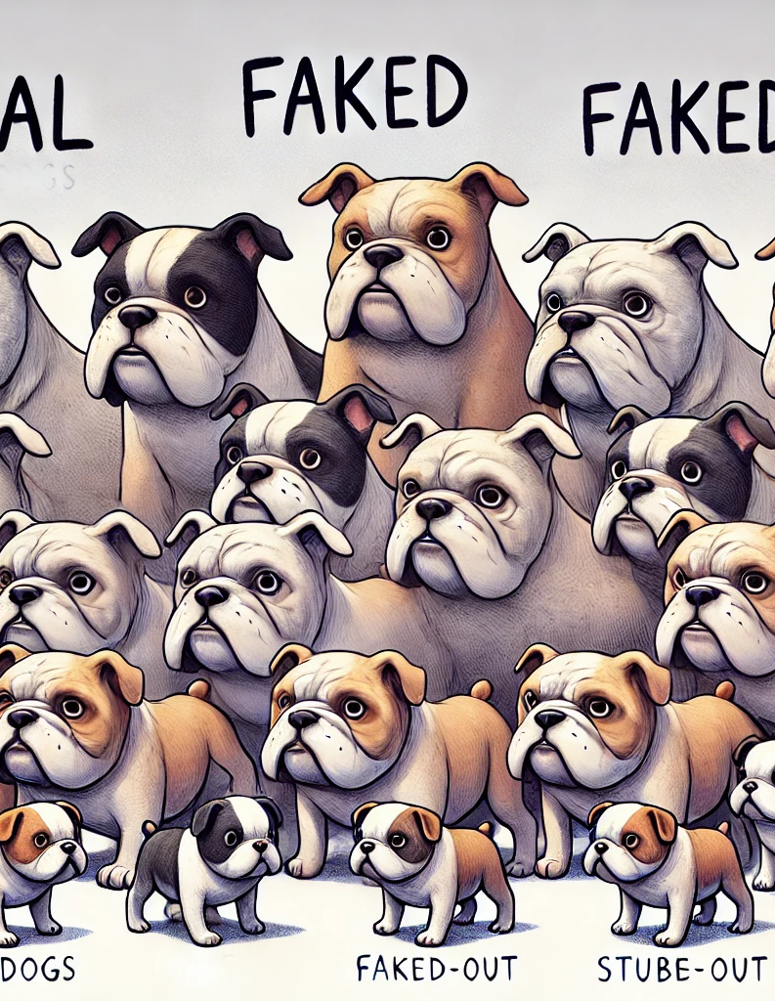
Stubs, Mocks, Fakes, Spies, and Doubles
Stubs: Provide predefined responses to method calls.
Mocks: Verify interactions with dependencies.
Fakes: Implement simpler versions of complex dependencies.
Spies: Record information about the interactions, such as the number of times a method was called.
Test Doubles: General term for stubs, mocks, and fakes.
Notes:
(2:05 - 2:15) 10 minutes
**One Sentence Summary**
- "Explain the differences between stubs, mocks, fakes, spies, and test doubles, and their importance in TDD and unit testing."
**Detailed Notes**:
- **Overview**:
- **Definition**:
- Stubs, mocks, fakes, spies, and test doubles are all types of test doubles used to isolate the unit under test by replacing real dependencies with controlled substitutes.
- **Importance**:
- These techniques are crucial for TDD and unit testing because they help simulate the behavior of complex dependencies, making tests more reliable and focused on the unit being tested.
- **Example**:
- "In a unit test for a service that fetches data from an API, a stub can be used to provide predefined responses, ensuring the test focuses on the service's logic rather than the API's behavior."
- **Stubs**:
- **Explanation**:
- Stubs are test doubles that provide predefined responses to method calls, allowing you to simulate the behavior of dependencies.
- **Usage**:
- Stubs are typically used when the test needs specific data or behavior from a dependency but does not need to verify interactions with it.
- **Example**:
- "A stub might be used to return a fixed set of data when a database query method is called in a unit test."
- **Mocks**:
- **Explanation**:
- Mocks are test doubles that verify interactions with dependencies, ensuring that the unit under test interacts with its dependencies as expected.
- **Usage**:
- Mocks are used when the test needs to verify that certain methods were called or interactions occurred.
- **Example**:
- "A mock might be used to verify that a logging method was called when an error occurs in the unit under test."
- **Fakes**:
- **Explanation**:
- Fakes are simpler implementations of complex dependencies that provide the same functionality but are easier to use in tests.
- **Usage**:
- Fakes are used when the test needs a working implementation of a dependency that is faster or simpler than the real one.
- **Example**:
- "A fake database might be used in unit tests to simulate database operations without the overhead of setting up a real database."
- **Spies**:
- **Explanation**:
- Spies are test doubles that record information about the interactions, such as the number of times a method was called and with what arguments.
- **Usage**:
- Spies are useful for verifying that interactions occurred without specifying the behavior of the dependency.
- **Example**:
- "A spy might be used to record how many times a function was called and with what parameters, allowing the test to verify that the function was used correctly."
- **Test Doubles**:
- **Explanation**:
- Test doubles is a general term that encompasses stubs, mocks, fakes, spies, and other types of controlled substitutes used in testing.
- **Purpose**:
- The purpose of test doubles is to isolate the unit under test by replacing its real dependencies, allowing for more focused and reliable tests.
- **Example**:
- "In a unit test for a payment processing service, various test doubles can be used to simulate the behavior of external services, databases, and other dependencies."
**Background Information**:
- **History of Test Doubles**:
- The concept of test doubles has evolved with the practice of unit testing and TDD. Early unit testing frameworks and methodologies, such as JUnit and XP, emphasized the importance of isolating the unit under test. The terminology and specific types of test doubles have been refined over time, with influential works like Gerard Meszaros's "xUnit Test Patterns" providing a comprehensive taxonomy and best practices for using test doubles in testing.
**Example**:
- **Real-world Scenario**:
- "In a microservices architecture, unit tests for each service often use test doubles to simulate the behavior of other services. For example, a mock service might be used to verify that a service correctly calls another service's API, while a stub might provide predefined responses for those API calls during testing."

Slide 6

Task API Application Overview
Overview of the Application: Describe the purpose and structure of the task application.
In-Memory Database: Explain the use of SQLite for simplicity and quick setup.
Demo of Migrations: Show how migrations set up the database schema.
Notes:
(2:15 - 2:30) 15 minutes
**One Sentence Summary**
- "Introduce the structure and components of the API application, and explain the use of an in-memory database for simplicity."
**Detailed Notes**:
- **Overview of the Application**:
- **Purpose**:
- The task application is a simple API designed to manage tasks, allowing users to create, read, update, and delete tasks.
- **Structure**:
- The application follows a typical API structure with defined endpoints for interacting with task data.
- **Example**:
- "Users can create new tasks, view a list of tasks, update existing tasks, and delete tasks using the API endpoints."
- **Components**:
- **Models**:
- Represent the data structure of the application. In this case, a Task model with properties such as `id`, `title`, `description`, `dueDate`, and `priority`.
- **Example**:
- "The Task model defines the fields and their data types for each task, such as `title` (string), `description` (string), `dueDate` (DateTime), and `priority` (enum)."
- **Controllers**:
- Handle the incoming requests, process them, and return appropriate responses. They contain the logic for each endpoint.
- **Example**:
- "The TaskController includes methods like `GetTasks`, `CreateTask`, `UpdateTask`, and `DeleteTask`, each corresponding to an API endpoint."
- **Views**:
- Present the data to the user. In a RESTful API, this is typically done in JSON format.
- **Example**:
- "When a user requests the list of tasks, the API returns the task data in JSON format, which can be easily consumed by client applications."
- **In-Memory Database**:
- **Explanation**:
- An in-memory database like SQLite is used for simplicity and quick setup. It stores data in memory rather than on disk, making it faster and easier to manage during development.
- **Benefits**:
- Using an in-memory database eliminates the need for complex database setup and configuration, allowing developers to focus on the application logic.
- **Example**:
- "SQLite can be configured to run entirely in memory, making it ideal for testing and development environments where persistent storage is not required."
- **Demo of Migrations**:
- **Explanation**:
- Migrations are used to manage and apply changes to the database schema over time, such as creating tables, adding columns, or modifying existing structures.
- **How It Works**:
- Migrations are typically defined in code and applied through a command-line tool or as part of the application's startup process.
- **Example**:
- "We'll run a migration script to create the initial Task table in our SQLite database. This script defines the schema for the Task model and ensures the database is set up correctly."
- **Demo**:
- Show a live demonstration of running a migration to set up the database schema.
- "Let's run the migration to create our Task table. You can see that the table is created with columns for `id`, `title`, `description`, `dueDate`, and `priority`."
**Background Information**:
- **History of Migrations**:
- Database migrations have become a standard practice in modern software development to manage changes to the database schema. Tools like Flyway, Liquibase, and the migration features built into frameworks like Entity Framework in .NET and Django in Python have made it easier for developers to apply and track schema changes in a consistent and version-controlled manner.
- The concept of migrations emerged to address the challenges of maintaining database schemas across different environments (development, testing, production) and ensuring that changes are applied smoothly and predictably.
**Example**:
- **Real-world Scenario**:
- "In a real-world project, database migrations are crucial for evolving the database schema as the application grows. For instance, when adding a new feature that requires additional fields in the database, a migration script can be created to add the necessary columns and update the existing schema without disrupting the application."

Slide 7

Setting Up the Project
Ensure everyone has the project files and dependencies installed.
Review Existing Tests: Walk through the existing tests and explain how to run them.
Notes:
(2:30 - 2:40) 10 minutes
**One Sentence Summary**
- "Ensure participants have the project set up correctly and review how to run existing tests."
**Detailed Notes**:
- **Setup**:
- **Instructions**:
- Ensure everyone has the project files and dependencies installed.
- "Please make sure you have cloned the repository from GitHub and installed all necessary dependencies."
- **Dependencies**:
- Common dependencies might include the .NET SDK, any required NuGet packages, and database setup.
- "Run `dotnet restore` to install all the required NuGet packages."
- **Example**:
- "In your terminal, navigate to the project directory and run `dotnet build` to ensure the project builds successfully."
- **Review Existing Tests**:
- **Purpose**:
- Walk through the existing tests to understand the current testing setup and ensure participants know how to run tests.
- **Instructions**:
- "Let's open the test project and take a look at the existing tests. We'll use these as a foundation for our new tests."
- **Running Tests**:
- Demonstrate how to run the tests using the command line or an IDE.
- "To run the tests, use the command `dotnet test`. This will execute all the tests in the project and provide a summary of the results."
- **Example**:
- "Here is a sample test case for the Task model. It verifies that a new task can be created with valid properties. Let's run this test to see it in action."
- **Address Setup Issues**:
- **Common Issues**:
- Discuss common setup issues participants might encounter, such as missing dependencies, build errors, or configuration problems.
- "If you encounter any errors during setup, check that all dependencies are installed correctly and that your environment variables are configured properly."
- **Troubleshooting Tips**:
- Provide tips for troubleshooting common issues.
- "Make sure you have the correct version of the .NET SDK installed. You can verify this by running `dotnet --version`."
- **Support**:
- Offer assistance to participants who need help resolving setup issues.
- "If you're facing any problems, please raise your hand or send a message in the chat, and I'll assist you in resolving the issue."
**Background Information**:
- **Importance of Setup**:
- Proper setup is crucial for ensuring that all participants can follow along with the exercises and fully participate in the workshop. A consistent setup helps avoid disruptions and ensures everyone is on the same page.
- Setup issues are common in development environments, especially when working with multiple dependencies and configurations. Ensuring a smooth setup process is essential for productive development and learning experiences.
**Example**:
- **Real-world Scenario**:
- "In a real-world project, ensuring that all team members have the same development environment setup is critical for collaboration. Using tools like Docker can help create consistent development environments by packaging all dependencies and configurations in a container."
---
Let's review this slide. Are you satisfied with the content and notes, or would you like to make any adjustments before proceeding to the next slide?

Slide 8

Setup Continuous Integration using GitHub Actions
Overview of CI
Introduce GitHub Actions as a CI tool.
Setting Up CI
Notes:
(2:40 - 2:50) 10 minutes
**One Sentence Summary**
- "Introduce continuous integration with GitHub Actions and guide participants through setting it up for their project."
**Detailed Notes**:
- **Overview of CI**:
- **Definition**:
- Continuous Integration (CI) is a development practice where developers integrate code into a shared repository frequently, usually several times a day.
- **Benefits**:
- CI helps detect errors quickly, ensures the codebase is always in a deployable state, and reduces integration problems.
- **Example**:
- "By integrating code frequently and running automated tests, CI helps identify issues early, making it easier to fix them before they become significant problems."
- **GitHub Actions**:
- **Introduction**:
- GitHub Actions is a CI/CD tool provided by GitHub that allows you to automate workflows directly from your GitHub repository.
- **Capabilities**:
- GitHub Actions can automate tasks such as building, testing, and deploying code, running scheduled jobs, and integrating with other services.
- **Example**:
- "With GitHub Actions, you can set up workflows that automatically run tests every time a pull request is created or code is pushed to the repository."
- **Setting Up CI**:
- **Steps**:
- Create a new workflow file in your repository's `.github/workflows` directory.
- Define the steps to build and test your project.
- **Example**:
- "Let's create a new workflow file named `ci.yml` in the `.github/workflows` directory. This file will define the steps for our CI process."
- **Example Workflow**:
- **Configuration**:
- Provide a simple workflow configuration for setting up CI with GitHub Actions.
- **Sample YAML**:
- "Here's an example workflow configuration for a .NET project:
```yaml
name: CI
on: [push, pull_request]
jobs:
build:
runs-on: ubuntu-latest
steps:
- uses: actions/checkout@v2
- name: Set up .NET
uses: actions/setup-dotnet@v1
with:
dotnet-version: '5.0.x'
- name: Install dependencies
run: dotnet restore
- name: Build
run: dotnet build --no-restore
- name: Test
run: dotnet test --no-build --verbosity normal
```
- "This workflow runs on every push or pull request, sets up .NET, installs dependencies, builds the project, and runs tests."
- **Hands-On Exercise**:
- **Guidance**:
- Guide participants through creating their own GitHub Actions workflow.
- **Steps**:
- Create the workflow file.
- Define the build and test steps.
- Commit and push the workflow file to the repository.
- **Example**:
- "Now, let's create the `ci.yml` file in your repository and define the steps to build and test your project. Once you've done that, commit and push the file to trigger the workflow."
**Background Information**:
- **History of CI**:
- The practice of continuous integration was first introduced by Grady Booch in the 1990s and later popularized by the Extreme Programming (XP) methodology. The goal of CI is to improve software quality and reduce the time taken to deliver new features by integrating work frequently and running automated tests on each integration.
- GitHub Actions, introduced in 2019, provides a flexible and powerful way to automate workflows directly within GitHub, making it easier for developers to implement CI/CD practices.
**Example**:
- **Real-world Scenario**:
- "In a large development team, setting up CI with GitHub Actions can streamline the development process by ensuring that all code changes are automatically tested. For example, every time a developer pushes code to the repository, GitHub Actions can run tests to catch any issues early, ensuring a stable codebase."

Slide 9
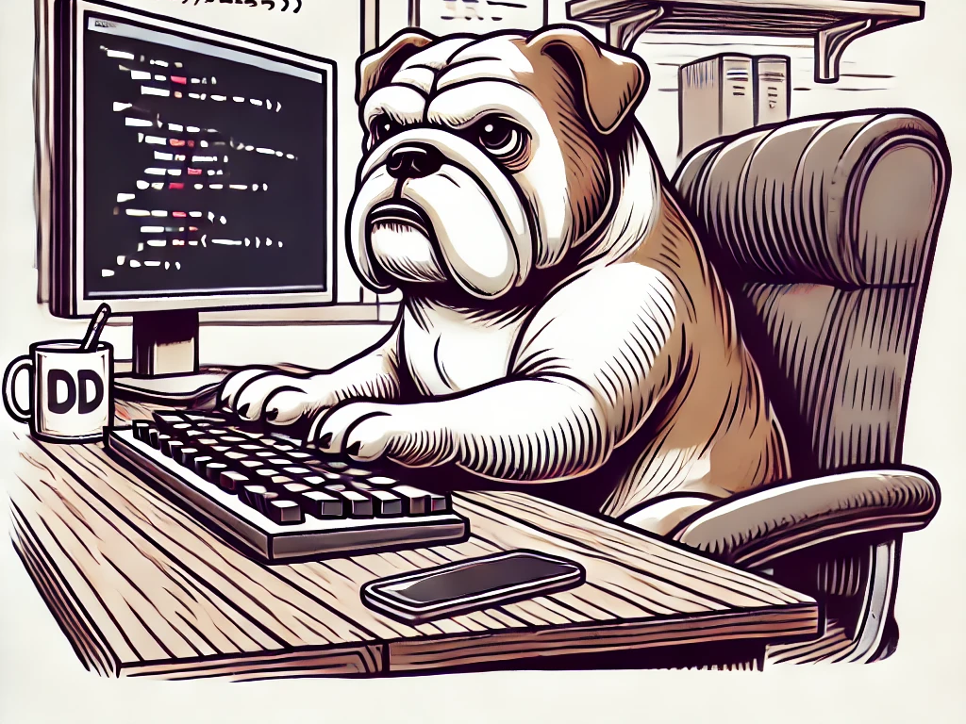
Add a Feature to the Task API
Notes:
(2:50 - 3:35) 45 minutes
**One Sentence Summary**
- "Guide participants through adding a new 'Priority' field to the task model, ensuring it returns text values and orders tasks by priority and due date."
**Detailed Notes**:
- **Add 'Priority' Field**:
- **Explanation**:
- Introduce a new field called `Priority` to the Task model. This field will indicate the importance of each task.
- **Enum Values**:
- Define the `Priority` field as an enum with values `Low`, `Medium`, and `High`.
- **Example**:
- "We'll add a `Priority` field to the Task model with enum values: `Low`, `Medium`, and `High`. This will help categorize tasks based on their importance."
- **Return Text for Priority**:
- **API Response**:
- Modify the API to return text values (`low`, `medium`, `high`) for the `Priority` field instead of numeric values.
- **Implementation**:
- Update the Task model and API controller to handle the conversion from enum to string.
- **Example**:
- "When a task is retrieved through the API, the `Priority` field should return `low`, `medium`, or `high` as text. This makes the API response more readable and user-friendly."
- **Order Tasks by Priority and Due Date**:
- **Sorting Logic**:
- Explain how to order tasks first by priority (with `High` being highest) and then by due date (most recent first).
- **Implementation**:
- Update the query logic in the controller to apply the sorting criteria.
- **Example**:
- "Tasks should be sorted such that high-priority tasks appear first, followed by medium and low-priority tasks. Within each priority level, tasks should be sorted by due date in descending order."
- **Hands-On Exercise**:
- **Guidance**:
- Provide step-by-step instructions for participants to implement the new feature.
- **Steps**:
- Update the Task model to include the `Priority` field.
- Modify the API controller to handle the new field and sorting logic.
- Write unit tests to verify the new functionality.
- **Example**:
- "First, we'll update the Task model to include the `Priority` field. Next, we'll modify the controller to return the priority as text and implement the sorting logic. Finally, we'll write unit tests to ensure the feature works as expected."
**Background Information**:
- **Importance of Prioritization**:
- Prioritizing tasks is a common requirement in task management applications. It helps users focus on the most important tasks first, improving productivity and organization.
- Using enums for priorities is a common practice because it provides a clear and limited set of possible values, making the code easier to understand and maintain.
**Example**:
- **Real-world Scenario**:
- "In a task management application used by a project team, prioritizing tasks helps team members focus on high-priority items first. For instance, tasks marked as `High` priority might be critical bugs that need immediate attention, while `Low` priority tasks could be minor improvements or low-risk items."

Slide 10

Emergent Design
Emergent design is a design approach where the design of a system evolves incrementally as the system is developed, rather than being fully specified upfront
Notes:
(3:35 - 3:40) 5 minutes
#### Bullet Points:
- **Definition**
- Explain emergent design and how it evolves through the development process.
- **Benefits**
- Discuss the benefits of allowing design to emerge naturally.
- **Practical Application**
- Provide examples of how to apply emergent design in real projects.
#### Speaker Notes:
**One Sentence Summary**
- "Introduce the concept of emergent design and its significance in software development."
**Detailed Notes**:
- **Definition**:
- **Explanation**:
- Emergent design is a design approach where the design of a system evolves incrementally as the system is developed, rather than being fully specified upfront.
- **Characteristics**:
- Emergent design relies on continuous feedback, refactoring, and iterative development to improve and adapt the design over time.
- **Example**:
- "In an agile project, the design of a system might start with a simple architecture and evolve as new requirements are discovered and implemented."
- **Benefits**:
- **Flexibility**:
- Emergent design allows for flexibility and adaptability, enabling developers to respond to changing requirements and incorporate new insights as the project progresses.
- **Reduced Risk**:
- By not committing to a rigid design upfront, emergent design reduces the risk of making costly design mistakes that need to be undone later.
- **Continuous Improvement**:
- The iterative nature of emergent design promotes continuous improvement, leading to a more robust and well-adapted system over time.
- **Example**:
- "Instead of trying to anticipate all possible future requirements, emergent design focuses on solving immediate problems and improving the design as new information becomes available."
- **Practical Application**:
- **Start Simple**:
- Begin with a simple design that addresses the current requirements and is easy to understand and extend.
- **Iterate and Refactor**:
- Continuously iterate on the design by refactoring the code to improve its structure, readability, and performance.
- **Use Feedback**:
- Incorporate feedback from testing, code reviews, and user feedback to inform design decisions and guide improvements.
- **Example**:
- "In a web application, you might start with a basic MVC architecture and evolve it by adding patterns such as the Repository pattern or CQRS as the application's complexity grows and new requirements emerge."
**Background Information**:
- **History of Emergent Design**:
- Emergent design is closely associated with agile development methodologies, which emphasize iterative development, customer collaboration, and responsiveness to change. The concept aligns with the principles of Extreme Programming (XP) and the Agile Manifesto, which advocate for embracing change and continuously improving the design of the system.
- Notable proponents of emergent design include Kent Beck and Martin Fowler, who have written extensively about the importance of adaptive and iterative design practices in software development.
**Example**:
- **Real-world Scenario**:
- "In a startup environment, emergent design can be particularly valuable. Startups often operate under conditions of high uncertainty, and requirements can change rapidly. By adopting an emergent design approach, a startup can quickly adapt its software to meet new market demands and user feedback without being constrained by an overly rigid initial design."

Slide 11

Simple Design
Four Rules of Simple Design
Runs all the tests:
Contains no duplication:
Expresses the intent of the programmer
Minimizes the number of classes and methods**:
Notes:
(3:40 - 3:55) 5 minutes
**One Sentence Summary**
- "Discuss the principles of simple design according to Kent Beck and its benefits in creating maintainable and efficient code."
**Detailed Notes**:
- **Definition**:
- **Explanation**:
- Simple design focuses on creating the simplest solution that works, adhering to principles like YAGNI (You Aren't Gonna Need It) and KISS (Keep It Simple, Stupid).
- **Core Principles**:
- Simple design should make the system easy to understand, maintain, and extend. It avoids unnecessary complexity and over-engineering.
- **Example**:
- "A simple design for a task management system might involve a straightforward CRUD (Create, Read, Update, Delete) interface without adding unnecessary features or layers of abstraction."
- **Four Rules of Simple Design** (by Kent Beck):
- **Runs all the tests**:
- Ensure that the system passes all automated tests, confirming that the code meets the specified requirements and behaves as expected.
- **Example**:
- "A task management application should have automated tests for creating, updating, and deleting tasks. Ensuring that all tests pass confirms the application works correctly."
- **Contains no duplication**:
- Avoid redundancy in the code by eliminating duplicate logic, making the system easier to maintain and reducing the risk of inconsistencies.
- **Example**:
- "If the logic for calculating task priorities is needed in multiple places, extract it into a single method or service to avoid duplication."
- **Expresses the intent of the programmer**:
- Write code that clearly communicates its purpose and logic, making it easier for others to understand and maintain.
- **Example**:
- "Use meaningful variable and method names like `calculateTaskPriority` instead of generic names like `calcPriority` to make the code more readable."
- **Minimizes the number of classes and methods**:
- Keep the design as simple as possible by avoiding unnecessary classes and methods, which can add complexity without providing additional value.
- **Example**:
- "Avoid creating a separate class for simple tasks that can be handled within an existing class, unless it significantly improves code organization or clarity."
- **Benefits**:
- **Readability and Maintainability**:
- Simple designs are easier to read and maintain, reducing the cognitive load on developers and making it easier to onboard new team members.
- **Flexibility**:
- Simple designs are more adaptable to change, allowing the system to evolve naturally as requirements change.
- **Reduced Risk of Bugs**:
- By avoiding unnecessary complexity, simple designs reduce the risk of introducing bugs and making the system harder to debug.
- **Example**:
- "In a microservices architecture, a simple design might involve using RESTful endpoints for communication rather than implementing a complex messaging system unless it is absolutely necessary."
- **Practical Application**:
- **YAGNI (You Aren't Gonna Need It)**:
- Implement only what is necessary for the current requirements. Avoid adding features based on speculative future needs.
- **KISS (Keep It Simple, Stupid)**:
- Strive for simplicity in design and implementation. Avoid overcomplicating the code with unnecessary patterns or abstractions.
- **Refactoring**:
- Continuously refactor the code to remove complexity and improve clarity.
- **Example**:
- "When designing a user authentication system, start with basic username and password authentication. Only add additional features like OAuth or multi-factor authentication when they are truly needed."
**Background Information**:
- **History of Simple Design**:
- The concept of simple design is rooted in the early days of software engineering and has been a fundamental principle in agile methodologies. Kent Beck and Ward Cunningham emphasized simple design in Extreme Programming (XP), advocating for building only what is needed to meet current requirements and continuously improving the design through refactoring.
- The Agile Manifesto also reflects this principle with its emphasis on simplicity, stating, "Simplicity--the art of maximizing the amount of work not done--is essential."
**Example**:
- **Real-world Scenario**:
- "In a large enterprise system, adopting simple design principles can prevent the accumulation of technical debt. For example, when adding a new reporting feature, a simple design might involve generating reports directly from the database without initially building a complex reporting engine. As the need for more advanced reporting features grows, the design can be incrementally improved."

Slide 12

The 10-Minute Rule
The 10-Minute Rule states that the continuous integration (CI) build process should take no more than ten minutes from code commit to feedback
Notes:
(3:55 - 4:00) 5 minutes
**One Sentence Summary**
- "Explain the 10 Minute Rule for CI builds and its significance in maintaining an efficient development workflow."
**Detailed Notes**:
- **Definition**:
- **Explanation**:
- The 10 Minute Rule states that the continuous integration (CI) build process should take no more than ten minutes from code commit to feedback.
- **Purpose**:
- The rule aims to provide rapid feedback to developers, ensuring that any issues are identified and addressed quickly.
- **Example**:
- "If a developer commits code to the repository, the CI build should run tests, build the application, and provide feedback within ten minutes."
- **Benefits**:
- **Rapid Feedback**:
- Quick feedback helps developers identify and fix issues promptly, reducing the time between writing code and discovering errors.
- **Increased Productivity**:
- Short build times prevent long waiting periods, allowing developers to stay focused and productive.
- **Continuous Integration**:
- Ensuring that the build process is fast and efficient supports the principles of continuous integration, where code is frequently integrated and tested.
- **Example**:
- "In a large development team, a fast CI build process means that developers can quickly verify the impact of their changes and move on to other tasks without significant delays."
- **Practical Application**:
- **Optimizing Build Processes**:
- Identify and eliminate bottlenecks in the build process to ensure it completes within ten minutes.
- **Parallelizing Tests**:
- Run tests in parallel to reduce the overall testing time.
- **Incremental Builds**:
- Use incremental builds to avoid recompiling unchanged code, speeding up the build process.
- **Example**:
- "Configure your CI pipeline to run unit tests in parallel across multiple containers. Use tools like Jest or Mocha for JavaScript projects, which support parallel test execution, to reduce the overall testing time."
**Background Information**:
- **History of the 10 Minute Rule**:
- The 10 Minute Rule for CI builds is rooted in agile and lean software development practices, which emphasize the importance of rapid feedback loops. The rule helps maintain a smooth and efficient development workflow by ensuring that developers receive prompt feedback on their changes.
- The rule is particularly relevant in large projects with extensive test suites and complex build processes, where long build times can significantly impact productivity.
**Example**:
- **Real-world Scenario**:
- "In a continuous delivery pipeline, adhering to the 10 Minute Rule ensures that the deployment process remains fast and reliable. For instance, an e-commerce platform might have a CI pipeline that runs unit tests, integration tests, and builds the application within ten minutes, enabling frequent deployments and quick responses to market changes."

Slide 13

Legacy Code and TDD
Legacy code refers to existing code that is often outdated, lacks documentation, and has little or no automated tests.
Role of TDD: Explain how TDD can help improve and maintain legacy code.
Notes:
(4:00 - 4:15) 15 minutes
#### Bullet Points:
- **Definition of Legacy Code**
- Define legacy code and the challenges it presents.
- **Role of TDD**
- Explain how TDD can help improve and maintain legacy code.
- **Practical Application**
- Provide examples of applying TDD to legacy code.
#### Speaker Notes:
**One Sentence Summary**
- "Discuss the challenges of legacy code and how TDD can be used to improve and maintain it."
**Detailed Notes**:
- **Definition of Legacy Code**:
- **Explanation**:
- Legacy code refers to existing code that is often outdated, lacks documentation, and has little or no automated tests.
- **Challenges**:
- Working with legacy code can be difficult due to its complexity, lack of tests, and potential for introducing bugs when making changes.
- **Example**:
- "A codebase developed years ago without modern best practices and without automated tests is considered legacy code. Making changes to such a codebase can be risky and time-consuming."
- **Role of TDD**:
- **Explanation**:
- Test-Driven Development (TDD) involves writing tests before writing the actual code, ensuring that the code meets the required functionality and is covered by tests.
- **Benefits for Legacy Code**:
- TDD can help improve legacy code by incrementally adding tests and refactoring the code to make it more maintainable and understandable.
- **Steps to Apply TDD to Legacy Code**:
- Identify areas of the legacy code that need improvement.
- Write tests for the existing functionality.
- Refactor the code to improve its structure and readability while ensuring that the tests still pass.
- **Example**:
- "When working with a legacy codebase, start by writing characterization tests that capture the current behavior of the code. Then, refactor the code incrementally, using TDD to guide the changes and ensure that the functionality remains intact."
- **Practical Application**:
- **Characterization Tests**:
- Write tests that define the existing behavior of the legacy code. These tests help ensure that refactoring does not change the intended behavior.
- **Incremental Refactoring**:
- Refactor the legacy code in small, manageable steps, using TDD to guide the process and verify the changes.
- **Introduce New Features**:
- Use TDD to introduce new features or modify existing functionality in the legacy code, ensuring that new tests cover the changes.
- **Example**:
- "Suppose you're working with a legacy application that calculates discounts. Start by writing tests that verify the current discount calculation logic. Once you have tests in place, refactor the discount calculation code to improve its readability and maintainability. Finally, use TDD to add new discount rules or modify existing ones."
**Background Information**:
- **History of Legacy Code**:
- The term "legacy code" was popularized by Michael Feathers in his book "Working Effectively with Legacy Code." Feathers defines legacy code as code without tests and provides techniques for safely making changes to such codebases.
- Legacy code often arises from software that has been in use for a long time, with multiple developers contributing to it over the years. It can be challenging to work with due to outdated practices, lack of documentation, and the absence of automated tests.
**Example**:
- **Real-world Scenario**:
- "In a financial application, legacy code might handle critical calculations and transactions. By applying TDD, developers can write tests to capture the existing behavior and incrementally refactor the code to improve its structure. This approach reduces the risk of introducing errors and makes the codebase more maintainable."

Slide 14

Introduction to GitHub Actions and Deployment
Overview of GitHub Actions
Benefits of CI/CD
Notes:
(4:15 - 4:25) 10 minutes
**One Sentence Summary**
- "Introduce GitHub Actions for CI/CD and demonstrate how to deploy an application using free cloud providers."
**Detailed Notes**:
- **Overview of GitHub Actions**:
- **Explanation**:
- GitHub Actions is a CI/CD platform that allows you to automate workflows directly from your GitHub repository.
- **Capabilities**:
- It supports building, testing, and deploying code, running scheduled jobs, and integrating with other services.
- **Example**:
- "With GitHub Actions, you can automate tasks such as running tests every time code is pushed to the repository, building the application, and deploying it to production."
- **Benefits of CI/CD**:
- **Rapid Feedback**:
- Continuous integration provides immediate feedback on code changes, allowing developers to catch and fix issues early.
- **Consistency and Reliability**:
- Automated builds and tests ensure that the codebase is always in a deployable state, reducing the risk of errors in production.
- **Faster Releases**:
- Continuous deployment automates the release process, enabling more frequent and reliable updates to the application.
- **Example**:
- "Using CI/CD, a team can deploy new features and bug fixes multiple times a day, ensuring that users always have access to the latest improvements."
- **Introduction to Free Cloud Providers**:
- **Heroku**:
- A cloud platform that makes it easy to deploy, manage, and scale applications. Offers a free tier for small projects.
- "Heroku's free tier allows you to deploy and host applications with ease, making it a great choice for development and small-scale production use."
- **Vercel**:
- A platform optimized for frontend frameworks and static sites, offering seamless integration with GitHub and free hosting.
- "Vercel is ideal for deploying static sites and frontend applications. It provides automatic builds and deployments with every push to the repository."
- **Netlify**:
- A platform for deploying and managing modern web projects, offering continuous deployment, serverless functions, and free hosting.
- "Netlify's powerful features and free tier make it an excellent choice for deploying static sites and serverless applications."
- **Example Workflow**:
- **Configuration**:
- Provide a sample GitHub Actions workflow for deploying a .NET application to a free cloud provider.
- **Sample YAML**:
- "Here's an example workflow for deploying a .NET application to Heroku:
```yaml
name: Deploy to Heroku
on:
push:
branches:
- main
jobs:
build:
runs-on: ubuntu-latest
steps:
- uses: actions/checkout@v2
- name: Set up .NET
uses: actions/setup-dotnet@v1
with:
dotnet-version: '5.0.x'
- name: Build
run: dotnet build --configuration Release --no-restore
- name: Publish
run: dotnet publish --configuration Release --output ./publish
- name: Deploy to Heroku
env:
HEROKU_API_KEY: ${{ secrets.HEROKU_API_KEY }}
run: git push https://git.heroku.com/<your-heroku-app>.git main
```
- "This workflow runs on every push to the main branch, builds the application, and deploys it to Heroku."
**Background Information**:
- **History of CI/CD**:
- Continuous Integration (CI) and Continuous Deployment (CD) practices have become essential in modern software development. CI involves integrating code changes frequently and running automated tests to detect issues early. CD extends CI by automatically deploying code changes to production, ensuring that the latest changes are always available to users.
- GitHub Actions, introduced in 2019, has quickly become a popular choice for implementing CI/CD due to its seamless integration with GitHub repositories and its flexibility in defining workflows.
**Example**:
- **Real-world Scenario**:
- "A startup using GitHub Actions for CI/CD can quickly iterate on new features and deploy them to production multiple times a day. By using a free cloud provider like Heroku, they can manage their application hosting and scaling without significant upfront costs."

Slide 15

Hands-On Exercise: Deploying the Task Application
Demonstrate how to set up GitHub Actions for CI and configure deployment to a free cloud provider.
Hands-On Practice
Notes:
(4:25 - 4:30) 5 minutes
#### Bullet Points:
- **Instructor Demonstration**
- Set up GitHub Actions for CI and configure deployment to a free cloud provider.
- **Hands-On Practice**
- Guide participants through setting up their workflow and deploying their applications.
- **Provide Guidance and Support**
- Assist participants with any issues they encounter during the exercise.
#### Speaker Notes:
**One Sentence Summary**
- "Demonstrate setting up GitHub Actions for CI and deployment, and guide participants through deploying their task applications."
**Detailed Notes**:
- **Instructor Demonstration**:
- **Overview**:
- Demonstrate the process of setting up GitHub Actions for continuous integration and deployment to a free cloud provider, such as Heroku or Vercel.
- **Step-by-Step Setup**:
- **Step 1**: Create a new workflow file in the `.github/workflows` directory of the repository.
- "Let's start by creating a `deploy.yml` file in the `.github/workflows` directory of your repository."
- **Step 2**: Define the build and test steps.
- "We'll define steps to checkout the code, set up the environment, build the application, and run tests."
- **Step 3**: Configure deployment to the cloud provider.
- "Next, we'll add steps to deploy the built application to a free cloud provider like Heroku. This involves pushing the code to the Heroku remote repository."
- **Example**:
- "Here’s a sample workflow configuration for deploying to Heroku:
```yaml
name: Deploy to Heroku
on:
push:
branches:
- main
jobs:
build:
runs-on: ubuntu-latest
steps:
- uses: actions/checkout@v2
- name: Set up .NET
uses: actions/setup-dotnet@v1
with:
dotnet-version: '5.0.x'
- name: Build
run: dotnet build --configuration Release --no-restore
- name: Publish
run: dotnet publish --configuration Release --output ./publish
- name: Deploy to Heroku
env:
HEROKU_API_KEY: ${{ secrets.HEROKU_API_KEY }}
run: git push https://git.heroku.com/<your-heroku-app>.git main
```
- **Explanation**:
- "This workflow runs on every push to the main branch, builds the application, and deploys it to Heroku. The `HEROKU_API_KEY` is stored securely in GitHub Secrets."
- **Hands-On Practice**:
- **Guidance**:
- Provide step-by-step instructions for participants to set up their own CI/CD workflow and deploy their applications.
- **Steps**:
- **Step 1**: Create the workflow file in their repository.
- "Create a new file named `deploy.yml` in the `.github/workflows` directory."
- **Step 2**: Define the build and deployment steps.
- "Follow the sample configuration to define the steps for building and deploying the application."
- **Step 3**: Commit and push the workflow file.
- "Commit the `deploy.yml` file to your repository and push it to trigger the workflow."
- **Step 4**: Verify the deployment.
- "Check the Actions tab in your GitHub repository to monitor the progress of the workflow and verify that the application is deployed successfully."
- **Example**:
- "Let's create the `deploy.yml` file and define the steps to build and deploy your task application. Once done, commit and push the file to trigger the deployment process."
- **Provide Guidance and Support**:
- **Common Issues**:
- Discuss common issues participants might encounter during the setup and deployment process, such as authentication errors, incorrect configurations, or build failures.
- "If you encounter any errors, check the workflow logs in the GitHub Actions tab for detailed error messages."
- **Troubleshooting Tips**:
- Provide tips for troubleshooting common issues and resolving them quickly.
- "Ensure that your Heroku API key is correctly added to the GitHub Secrets and that the remote URL for Heroku is correct."
- **Support**:
- Offer assistance to participants who need help resolving setup and deployment issues.
- "If you face any problems during the exercise, please raise your hand or send a message in the chat, and I'll assist you in resolving the issue."
**Background Information**:
- **Importance of Hands-On Practice**:
- Hands-on exercises are crucial for reinforcing theoretical concepts and giving participants practical experience. By setting up CI/CD workflows and deploying applications, participants gain confidence in their ability to automate and streamline the deployment process.
- Deploying applications to cloud providers is a valuable skill in modern software development, as it allows for scalable, reliable, and efficient application management.
**Example**:
- **Real-world Scenario**:
- "In a professional setting, automating the deployment process with CI/CD tools like GitHub Actions ensures that new features and bug fixes can be quickly and reliably deployed to production. For example, an e-commerce website might use GitHub Actions to automatically deploy updates to their site, ensuring that the latest improvements are always available to users."

Slide 16

Wrap-Up and Q&A
Summarize Key Takeaways
Open Floor for Questions
Notes:
(4:30 - End)
**One Sentence Summary**
- "Recap the key points from the afternoon session, open the floor for questions, and conclude the course with a summary of key concepts and additional resources."
**Detailed Notes**:
- **Summarize Key Takeaways**:
- **CI/CD with GitHub Actions**:
- Highlight the importance of continuous integration and continuous deployment using GitHub Actions.
- "Today, we learned how to set up GitHub Actions for CI/CD, which helps in automating the build, test, and deployment processes."
- **Deployment to Free Cloud Providers**:
- Emphasize the ease and benefits of deploying applications to free cloud providers like Heroku, Vercel, and Netlify.
- "Deploying to cloud providers like Heroku allows us to host and manage our applications easily and cost-effectively."
- **Introduction to Prompt Engineering**:
- Recap the significance of crafting effective prompts for AI tools to enhance productivity and accuracy.
- "Crafting effective prompts for AI tools like GitHub Copilot and ChatGPT can significantly improve your coding efficiency and accuracy."
- **Open Floor for Questions and Discussions**:
- **Encourage Participation**:
- Invite participants to ask questions and share any challenges they faced during the exercises.
- "Now, let's open the floor for questions. Feel free to ask about any challenges you faced or any concepts you want further clarification on."
- **Provide Solutions**:
- Offer solutions and additional guidance based on the questions and discussions.
- "If you encountered issues with the deployment process, let's troubleshoot them together and find solutions."
- **Conclusion of the Course**:
- **Recap Key Concepts**:
- Summarize the key concepts learned over the two days, including TDD, software craftsmanship principles, AI tools, and CI/CD.
- "Over the past two days, we've covered essential concepts like Test-Driven Development, software craftsmanship principles, using AI tools like GitHub Copilot, and setting up CI/CD pipelines with GitHub Actions."
- **Additional Resources**:
- Provide additional resources for further learning and support.
- "For further learning, I recommend exploring the following resources:
- 'Test-Driven Development by Example' by Kent Beck
- 'Refactoring: Improving the Design of Existing Code' by Martin Fowler
- GitHub Actions documentation
- Heroku, Vercel, and Netlify documentation"
- **Contact Information**:
- Share contact information for further support and networking.
- "If you have any questions or need further assistance, feel free to contact me at [your email]. Let's stay connected on LinkedIn as well."
**Background Information**:
- **Importance of Continuous Learning**:
- Emphasize the importance of continuous learning and staying updated with the latest tools and practices in software development. Encourage participants to keep experimenting with new technologies and applying the principles learned during the course to their future projects.
**Example**:
- **Real-world Scenario**:
- "In a professional setting, applying the principles of TDD, software craftsmanship, and CI/CD can significantly improve the quality and reliability of your software. For instance, using TDD to drive development ensures that your code is well-tested and maintainable, while CI/CD automates the deployment process, enabling frequent and reliable updates to production."

Slide 17

Conclusion of the Course
Thank you!

